Slide 1

AIRBNB PRICE PREDICTION IN CANADA
JYOTI BALA
RAIHAANAH ABUBAKKAR SIDIQ
HARSH KUMAR
JOYAL PATEL
EZEKIEL AYENI
https://github.com/balajyoti/Price_predition_project.git

Slide 2
AGENDA
INTRODUCTION
WHY AIRBNB
MOTIVATION
CHALLENGES
TARGET AUDIENCE
DATA ASSESSMENT
EDA
PREDICTION MODEL
PREDICTION OBSERVATION
TABLEAU ANALYSIS
ANALYSIS OBSERVATIONS
REFERENCES

Slide 3
INTRODUCTION
Airbnb, Inc. is an American based company operating an online marketplace for short- term homestays and experiences. The company acts as a broker and charges a commission from each booking. The company was founded in 2008 by Brian Chesky, Nathan Blecharczyk, and Joe Gebbia. Airbnb is a shortened version of its original name, AirBedandBreakfast.com. The company is credited with revolutionizing the tourism industry.
Since its inception, Airbnb has hosted more than 60 million guests in 34,000 locations worldwide, and it has experienced rapid growth. For those who would otherwise have empty space as well as visitors looking for convenient and cheap housing options, Airbnb offers a convenient source of income.
The Canadian economy could gain $85 million from customer taxes and fees generated by the Airbnb industry in Canada.

Slide 4
WHY AIRBNB
A Trusted Accommodation
Convenient and Reliable
Vacation and Travelling Made Easy

Slide 5
MOTIVATION
Easy Airbnb selection
Maximize Earnings
Understanding Price listings
Correctly predicting price

Slide 6

CHALLENGES
Grouping the data into different segments.
Describing how machine learning and predictive modelling algorithms generate forecasts.
Selecting the Dataset from the Airbnb. There are too many cities.
Notes:
gettyimages-1061332616-2048x2048

Slide 7
TARGET AUDIENCE
Airbnb price prediction will be highly instrumental for traveler’s and individuals or group of individuals embarking on a vacation or visits to cities in Canada.
The project will also make it possible for Airbnb hosts and owners to gain a reasonable insight into the prevailing cost of Airbnb within the cities.

Slide 8
DATA ASSESSMENT
There are 6 different Airbnb datasets from different cities in Canada. We have grouped the data based on the population of the cities into 3 segments namely: Mega (Toronto and Montreal), Mid (Vancouver and Winnipeg), and Small (Quebec city and Victoria)
The merged Dataset has 18 variables and 34652 observations

Slide 9
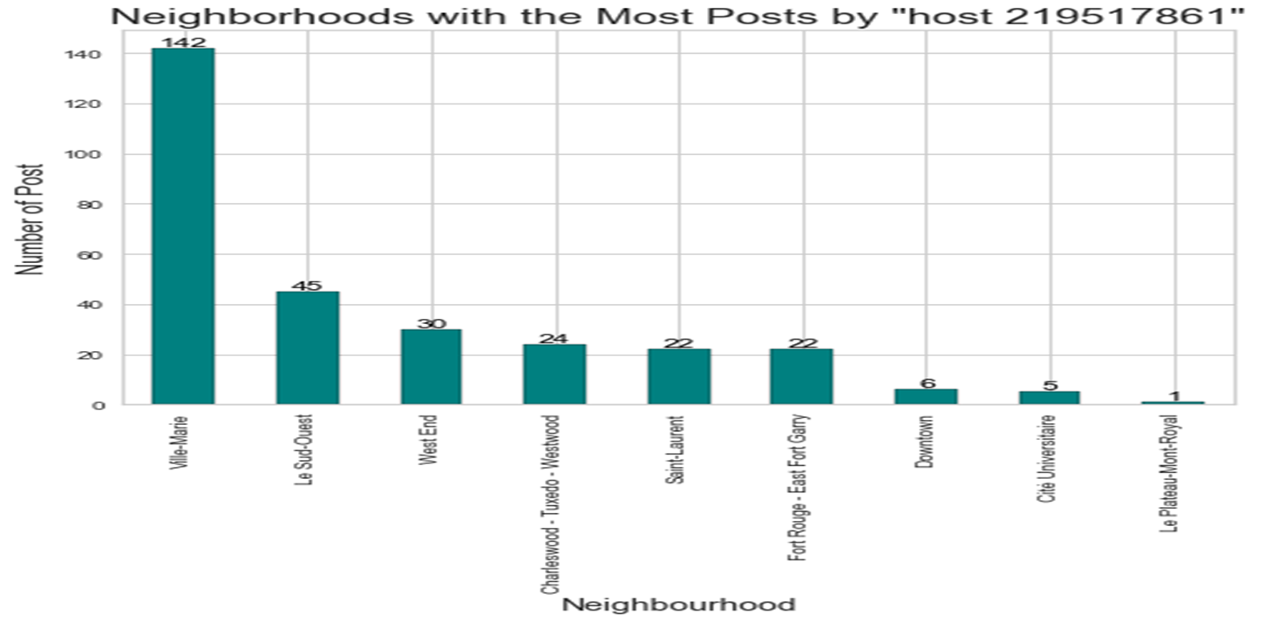
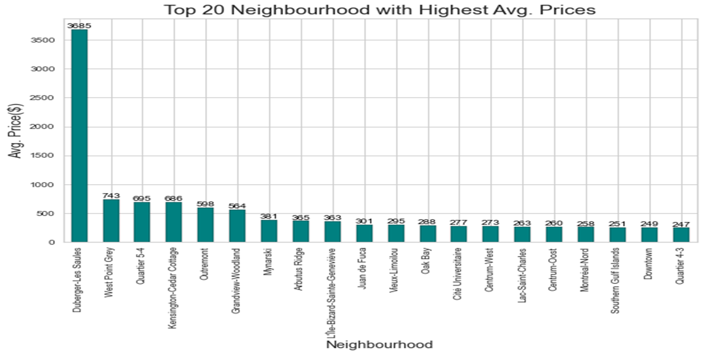
EDA
Number of posts by neighborhood
Top Neighborhoods with average price

Slide 10
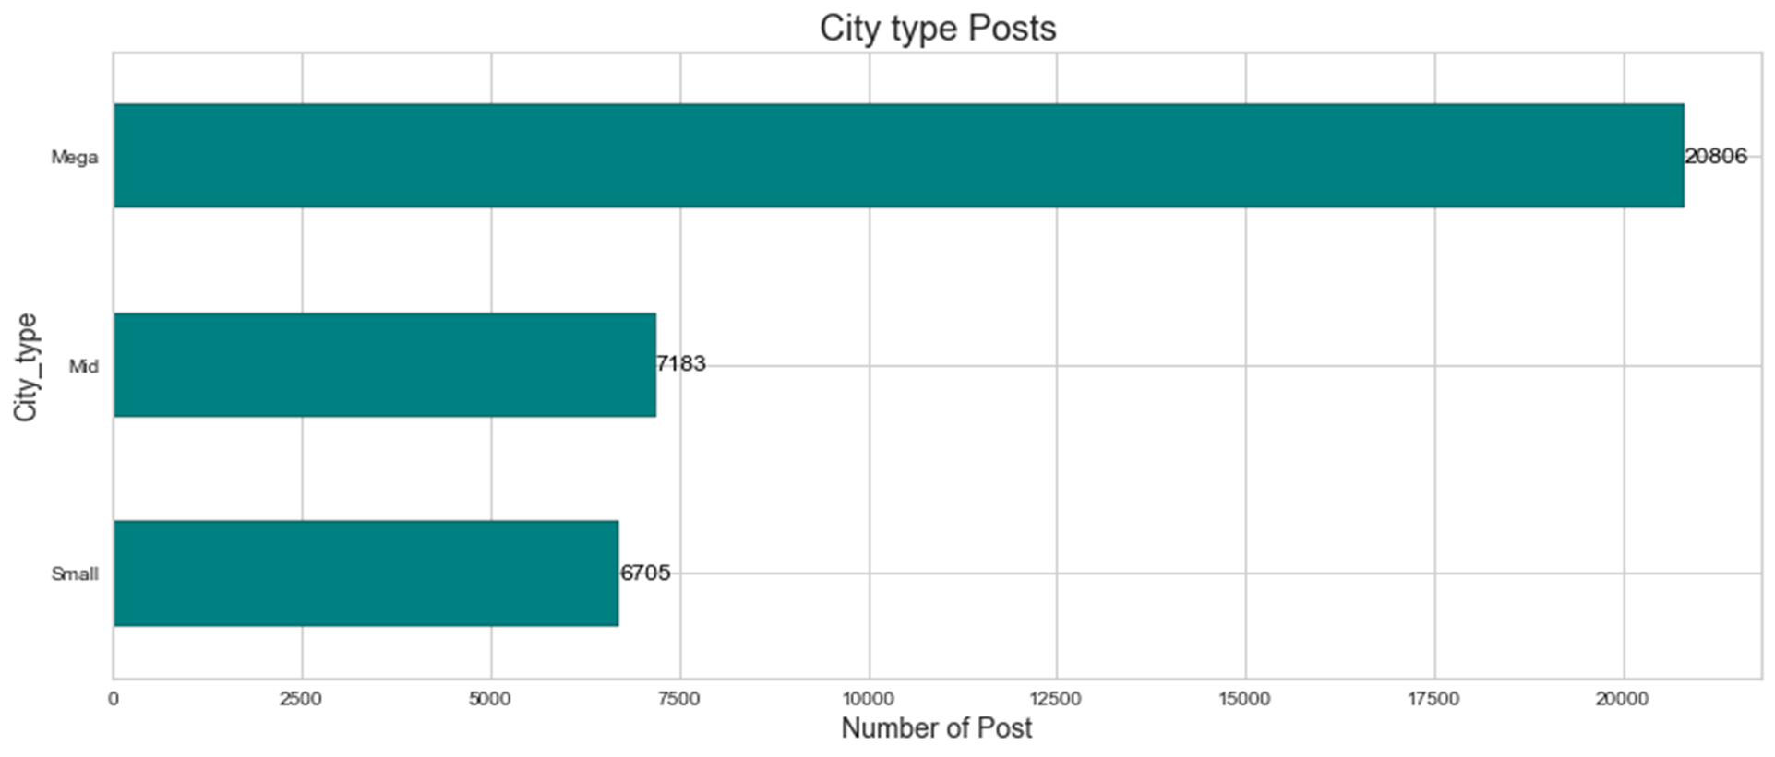
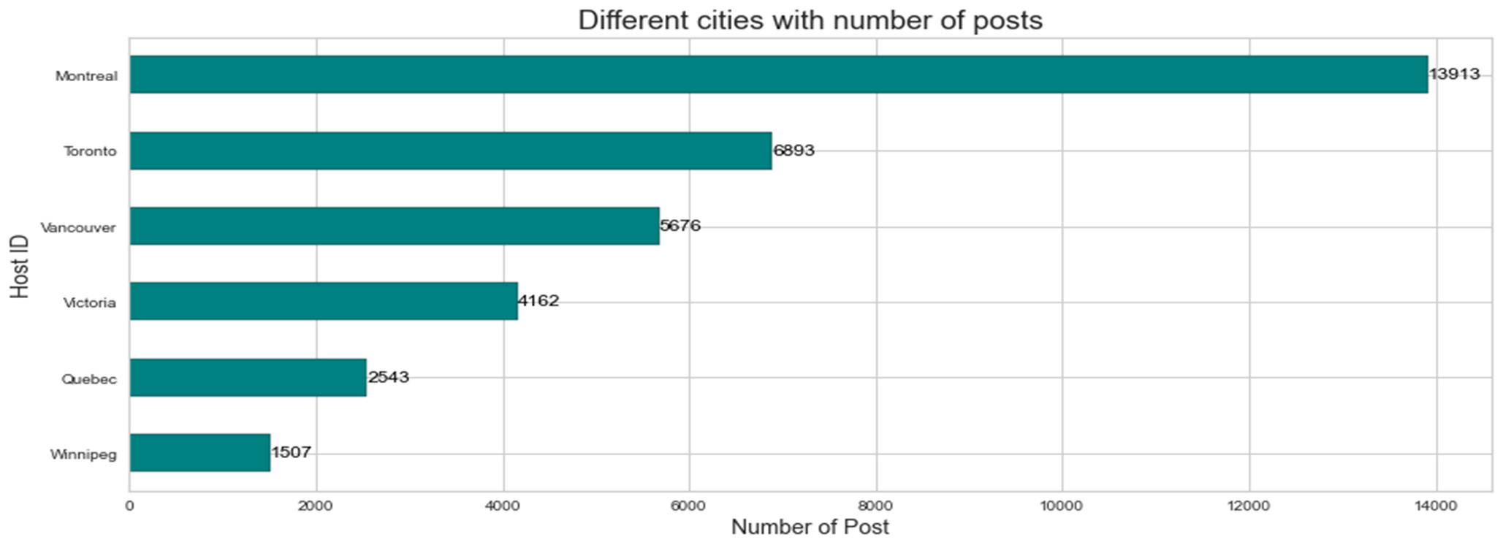
EDA Contd.
Number of posts by city type: Mega city has more listings
Number of posts by city:
Montreal has more listings

Slide 11
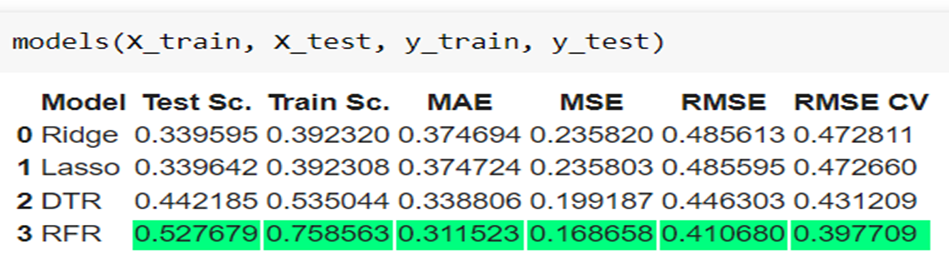
PREDICTION MODEL AND ACCURACY

Slide 12
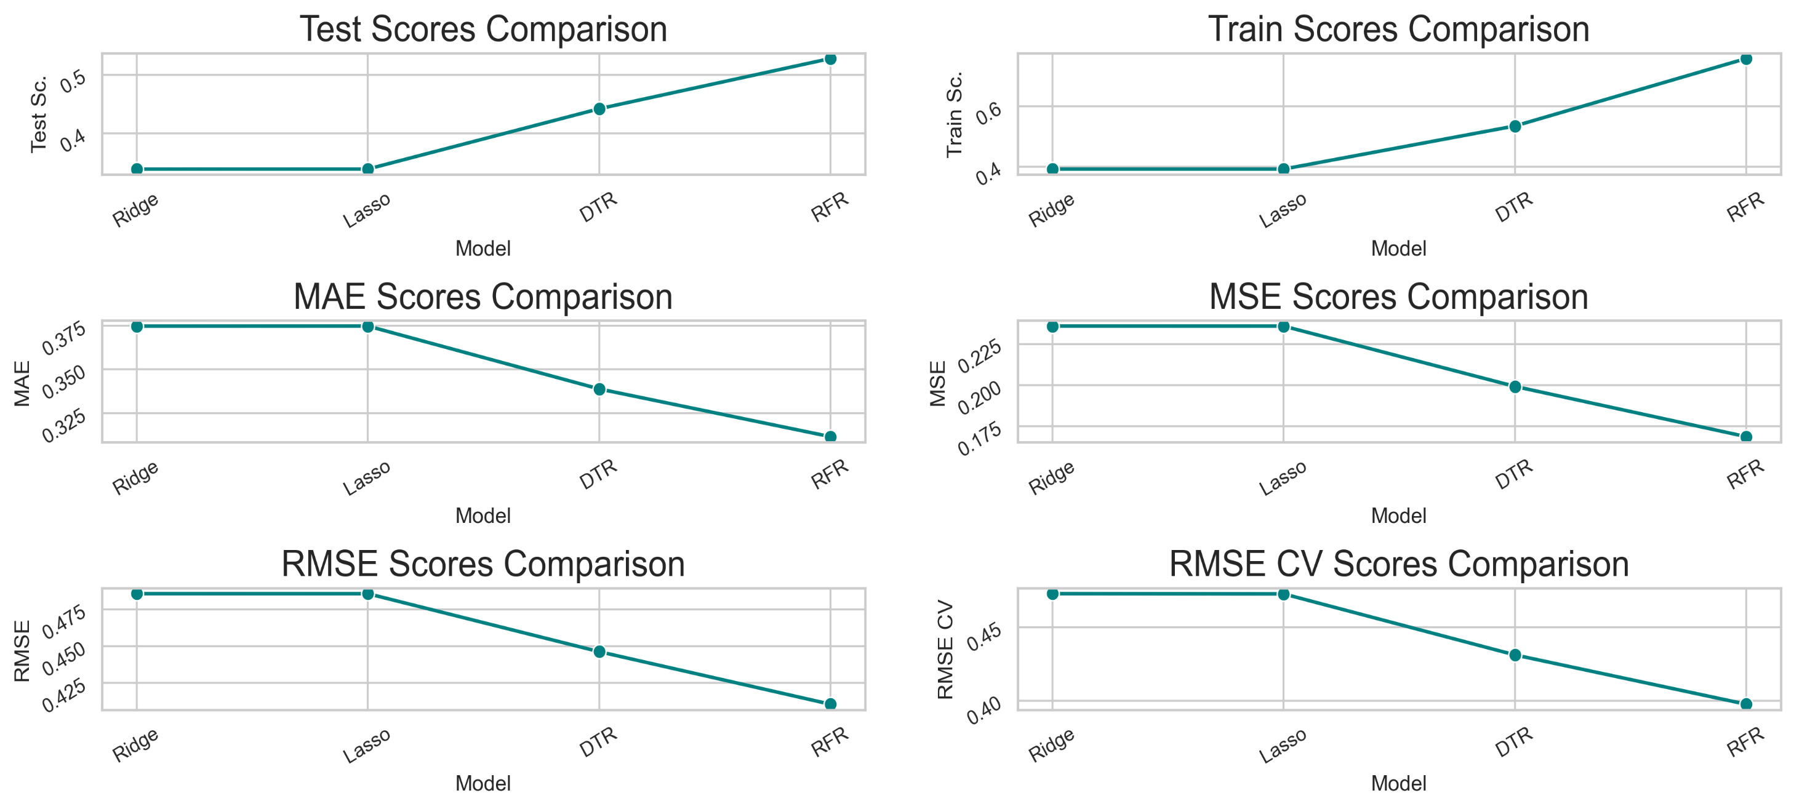
PREDICTION MODEL AND ACCURACY

Slide 13
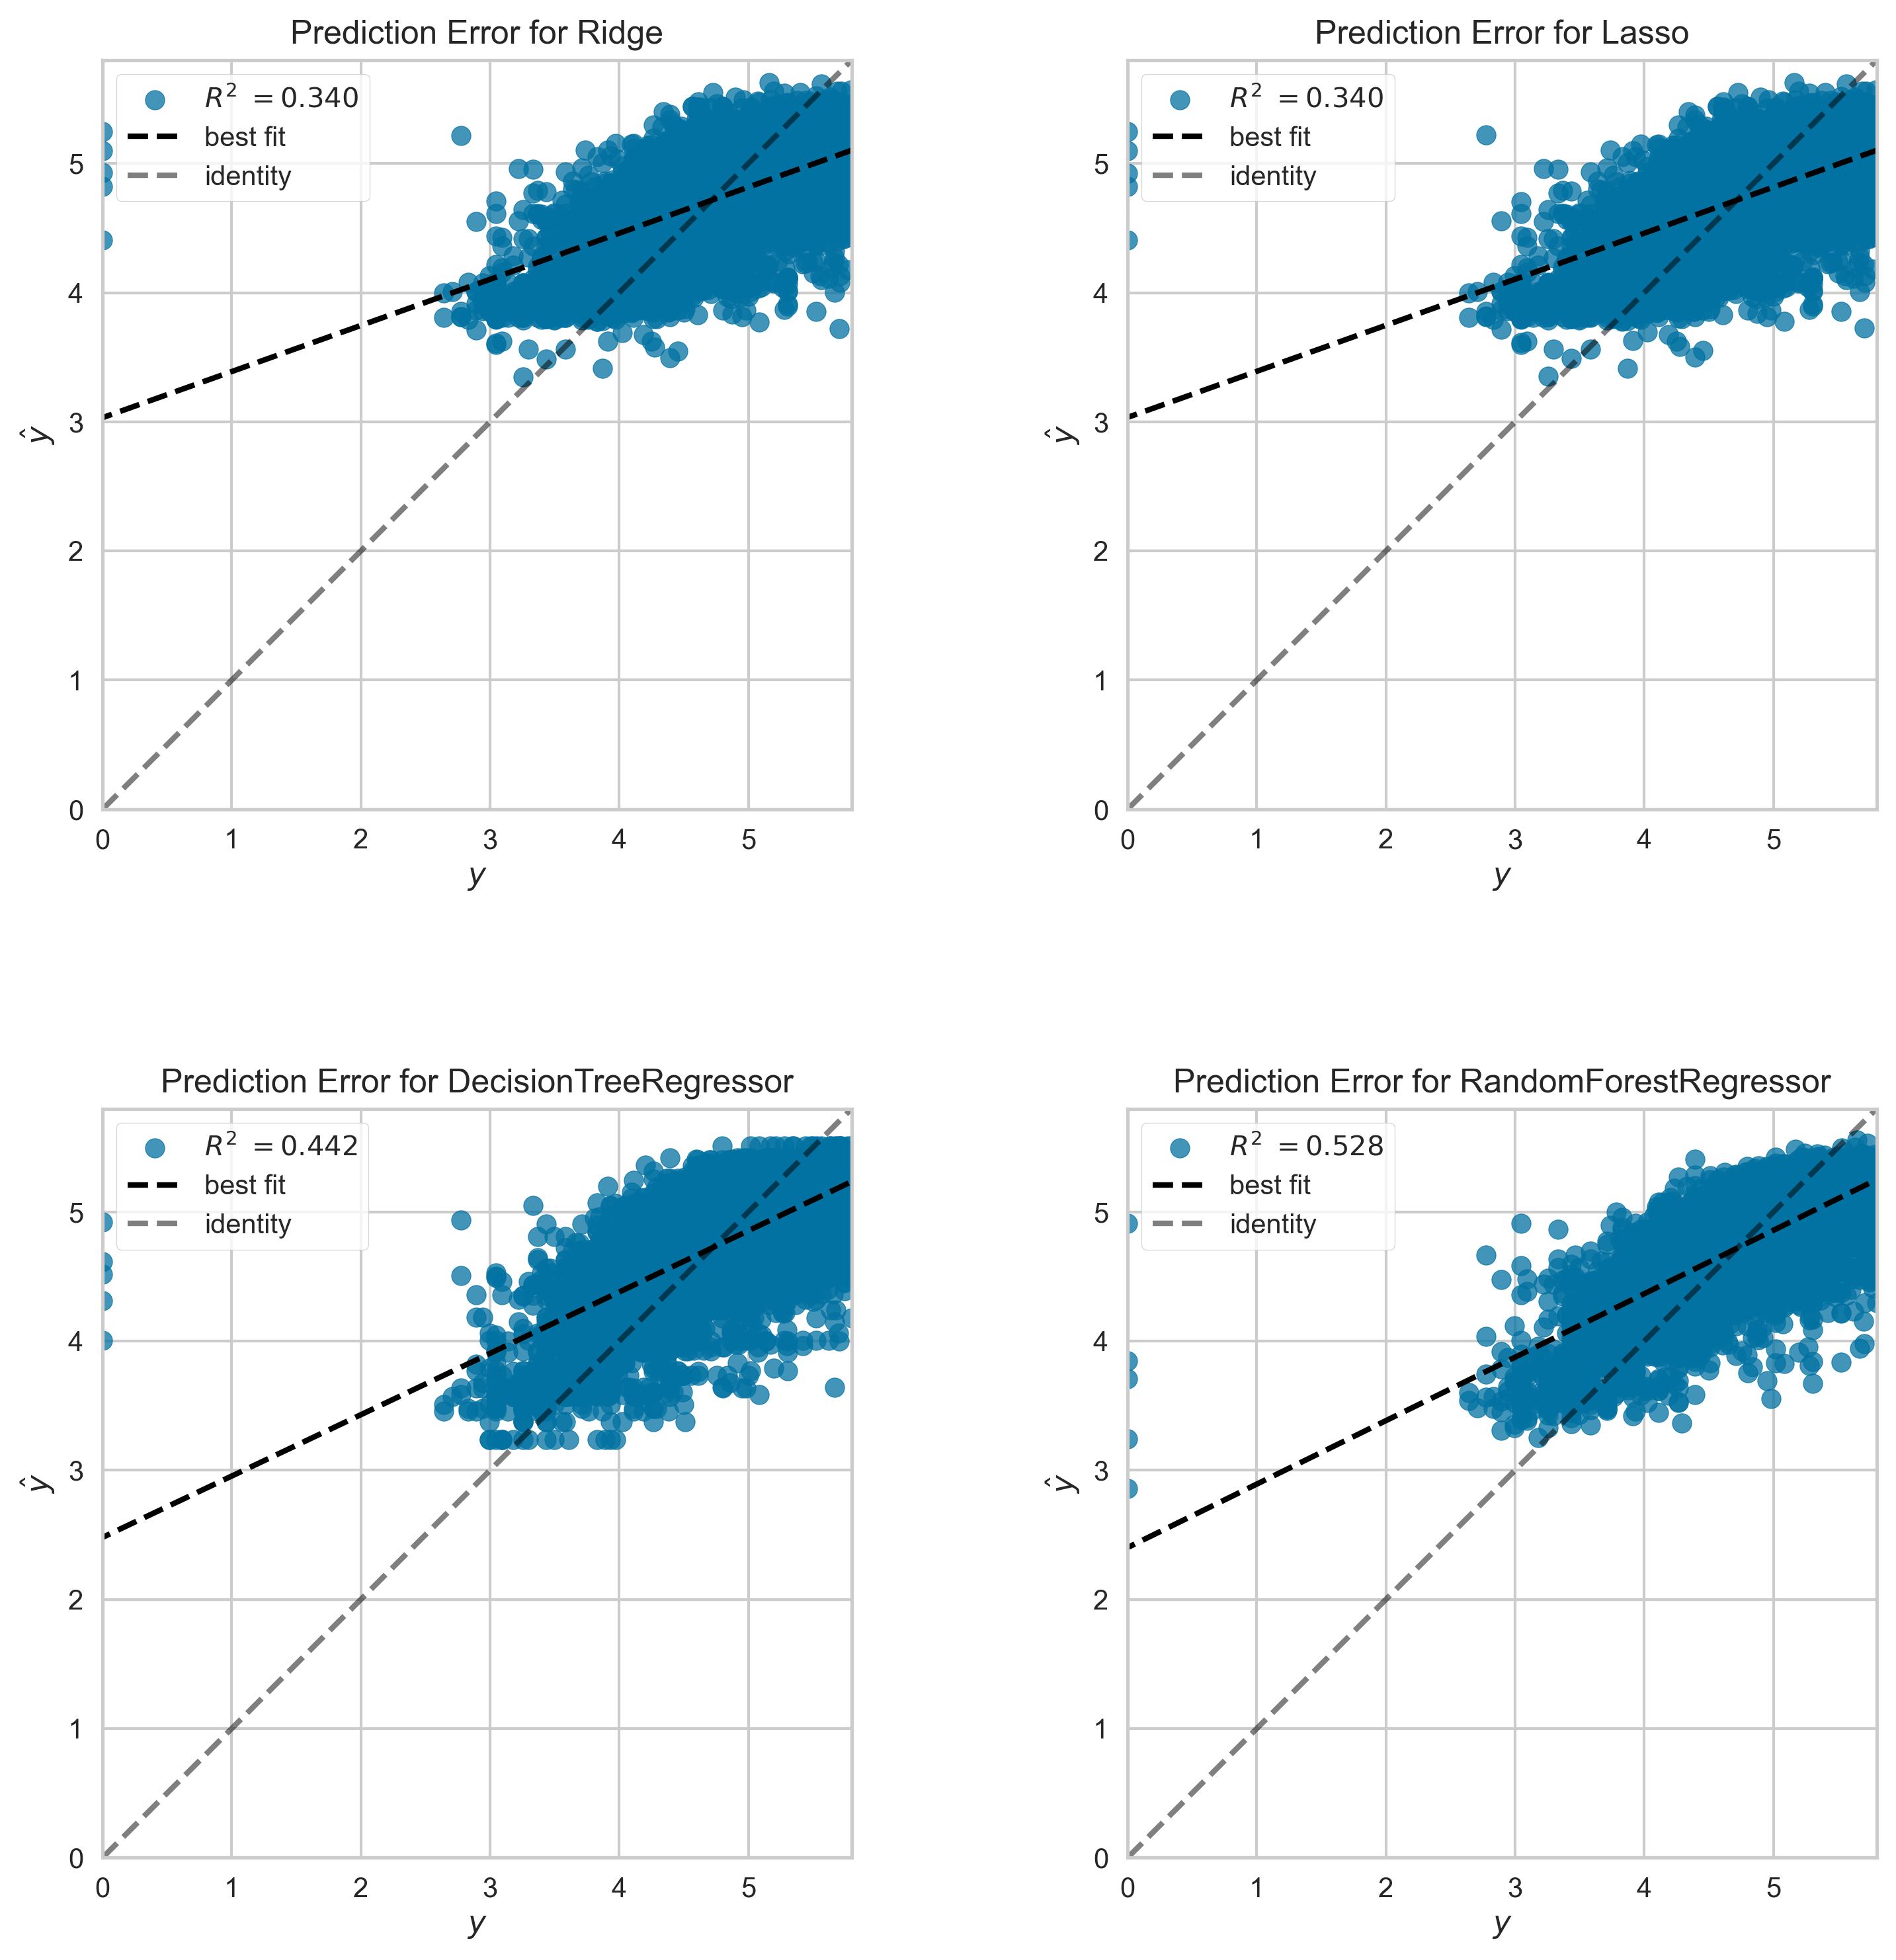
PREDICTION ERROR

Slide 14

PREDICTION OBSERVATION
The best model to choose would be the Random Forest Model. It performs better than the other three models: Ridge, Lasso, and Decision Tree models. Although it only predicts about 76% of the variation in price. It has the minimum error in predicting the price.

Slide 15
TABLEAU ANALYSIS

Slide 16
ANALYSIS OBSERVATIONS
From our analysis, it is evident that both city type and review has effect on the price of Airbnb.
Mid cities of Vancouver and Winnipeg has the highest and lowest average prices respectively.
The top and most expensive neighborhood is found in a Small city of Quebec.
Private room is most expensive generally, while entire home is cheapest in Vancouver.
Prices of Airbnb is on the increase in Toronto, Quebec, and Montreal
Most Expensive private room is located in the city Quebec.
Prices in Vancouver, Winnipeg, and Victoria are dropping
Least price of private room is found in Winnipeg.
The higher the reviews, the more the cost of Airbnb in both mega and small cities
Users should consider locations in Montreal, city of Quebec and Toronto where there is increase in reviews which may be due to higher
customer satisfaction
Entire home in Winnipeg is more affordable than any other city.
Quebec has the highest customer satisfaction based on the review while Montreal is the lowest.
Surprisingly, the cheapest room has the highest review. This could mean customers prefer lower cost rather than comfortability.

Slide 17
REFERNCES
Dataset: http://insideairbnb.com/get-the-data.html
Airbnb Website: https://www.airbnb.ca/
Airbnb Disclaimer: http://insideairbnb.com/about.html
https://en.wikipedia.org/wiki/Airbnb

Slide 18


